Slide 1
Socioculture and politics
~Shreya Bhandari

Slide 2
What is Socioculture?
Understanding of sociocultural factors is key for business. Any firm that aims to provide goods or services requires proper knowledge or at least basic information about its target group. This is particularly important when entering a new geographical market. When a company wants to start exporting, it is useful to comprehend how willing potential consumers are to accept and ultimately purchase its products

Slide 3
What is considered normal and regular in a society can be unusual or even extravagant and immoral in others. Assessing sociocultural factors answers questions such as: Are people used to eat vegetables on a daily basis? What is the attitude toward outdoor sports? Do housewives consider luxurious to have a microwave at home? By asking these questions and researching about social behaviors and cultural traditions companies can increase their chances to success in the market they are trying to serve.

Slide 4
Political ENvironment
Political Envoirment refers to environment in which the state,government and its institutions and legislations and the public and private stakeholders who operate and interact with business and influence the working of business in various ways.
Business organisation must be aware about the political environment so that it can functions according to the terms and conditions of Political environment.However if business fails to work according to the set rules and regulations strict action can be taken against it which will results in loss to business organisation.

Slide 5
Political Environment can be of utmost importance for a business.How a government make policies and what kind of economic measures it takes can determine the success or a failure of a business

Slide 6
Enlightened-self interest
~Nishtha Jagtap

Slide 7
Defination:
Enlightened self-interest is a philosophy in ethics which states that persons who act to further the interests of others (or the interests of the group or groups to which they belong), ultimately serve their own self-interest.
Enlightened self interest is a way to create good for self and good for all at the same time,including teammates,bosses,customers and organizations

Slide 8
Why Enlightened-self interest is important?
If human beings did not have an inherent will to protect themselves and further their own interests,they would not survive.
Knowing what is in your interests will help you get what is best for you and avoid what is harmful.It will keep you moving toward your goals and ensure that your goals are the right ones for you.
Contributing to the development and survival of the society in which you live will mean a better environment in which to pursue you interests.

Slide 9
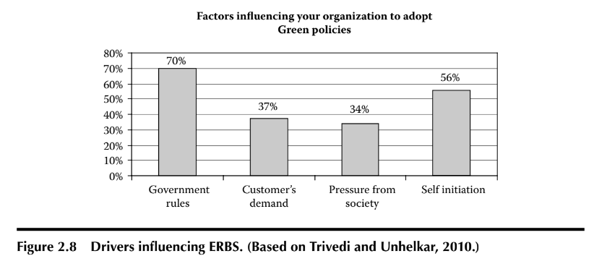
As seen in Figure 2.8, the survey results indicate that a substantial 56% respondents believe that self-initiation is a driver for undertaking green transformation
Figure also indicates that self-motivation has the potential to be an effective green driver for businesses.
A variation of driver known as incentive-driven compliance (IDC) incorporates innovation and self-motivation within its environmental approach for better carbon compliance.
Enlightened self-interest, as a driver, is in between the good behavior for financial gains and avoidance of bad, carbon-intensive behavior due to fear of penalties.

Slide 10
Enlightened self-interest is driver comes into play when an organization, on its own accord, realizes the need to be environmentally responsible, and
creates or adopts a green strategy.
This driver can include a range of interests including the desire of an organization to undertake genuine common good, the need of the business leadership to achieve personal satisfaction, or simply the understanding of the decision makers that costs can be reduced and customers can be more satisfied with a self-interest approach that also helps the environment.

Slide 11
THANK YOU

